Slide 1


The Evolutionary Status of
RE J0317-853
Baybars Külebi, Stefan Jordan, Ed Nelan, Matt Burleigh,
Uli Bastian, Martin Altmann, Fabian Euchner

Slide 2

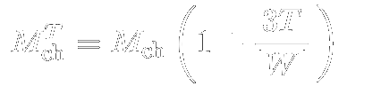

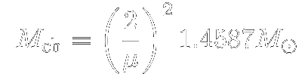
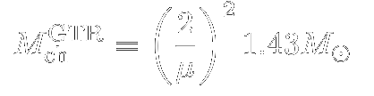

Angular momentum
Internal Magnetism
Chandrasekhar mass
General Relativistic Instability
Inverse Beta Decay

Slide 3
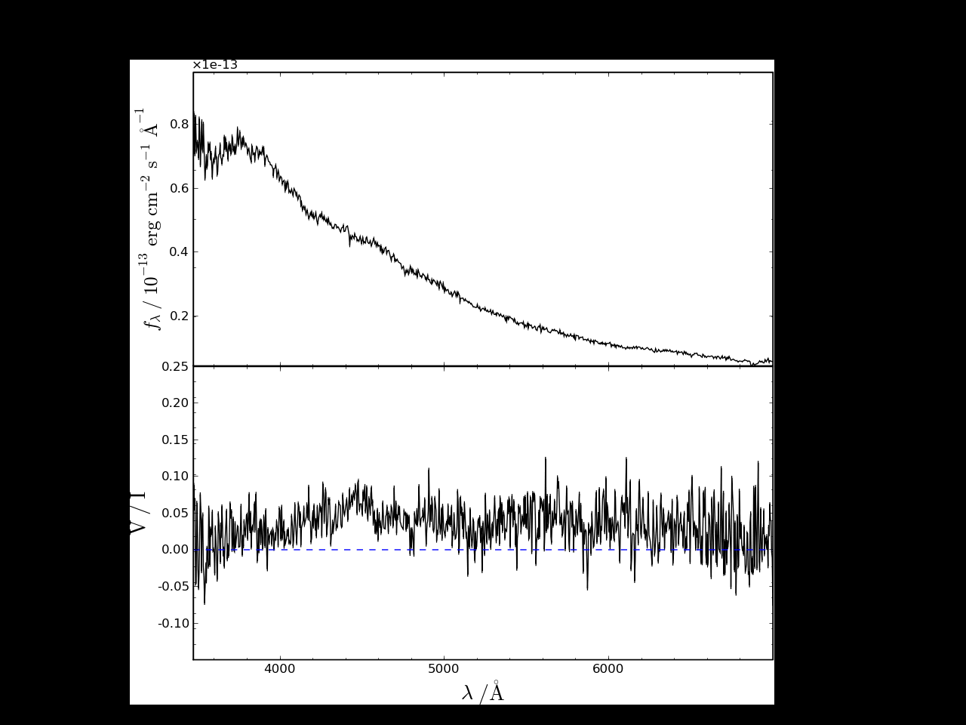
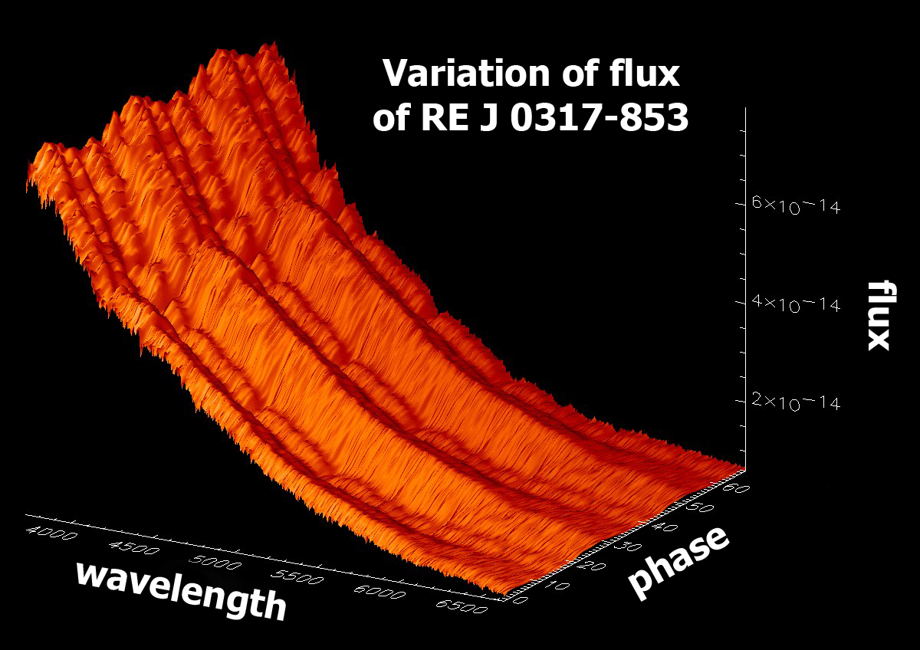
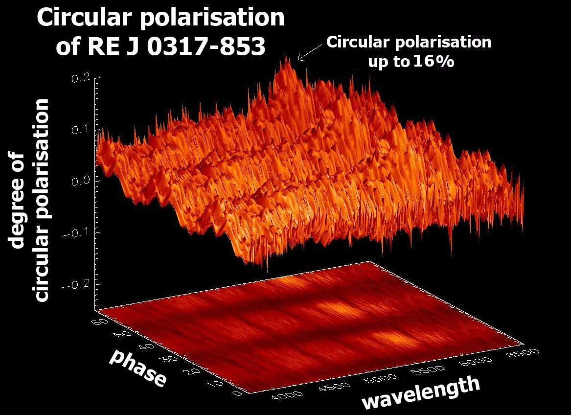
RE J0317-853
Phase resolved AAT spectra (Burleigh & Jordan 1998)
Discovered in a ROSAT EUV survey
P = 725.7277 s
M ~ 1.35 M⊙
T ~ 40000 K
B ~ 200 – 450 MG
Barstow et al. 1995
Ferrario et al. 1997
Burleigh et al. 1999
Vennes et al. 2003
Hansen et al. 2006
Farihi et al. 2008

Slide 4
Parallax Measurement and
Photometric Analysis

Slide 5
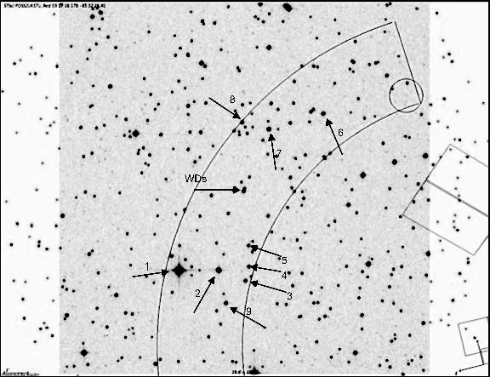
HST Observations
RE J0317 is a part
of a wide binary system, its companion a cooler white dwarf LB 9802.
Total age of RE J0317 and LB 9802 differs by ~30-300 Myr if a single star progenitor is assumed for RE J0317
Ferrario et al. (1997)
Sky plate of HST's Fine Guidance System. The numbered arrows point to reference stars

Slide 6
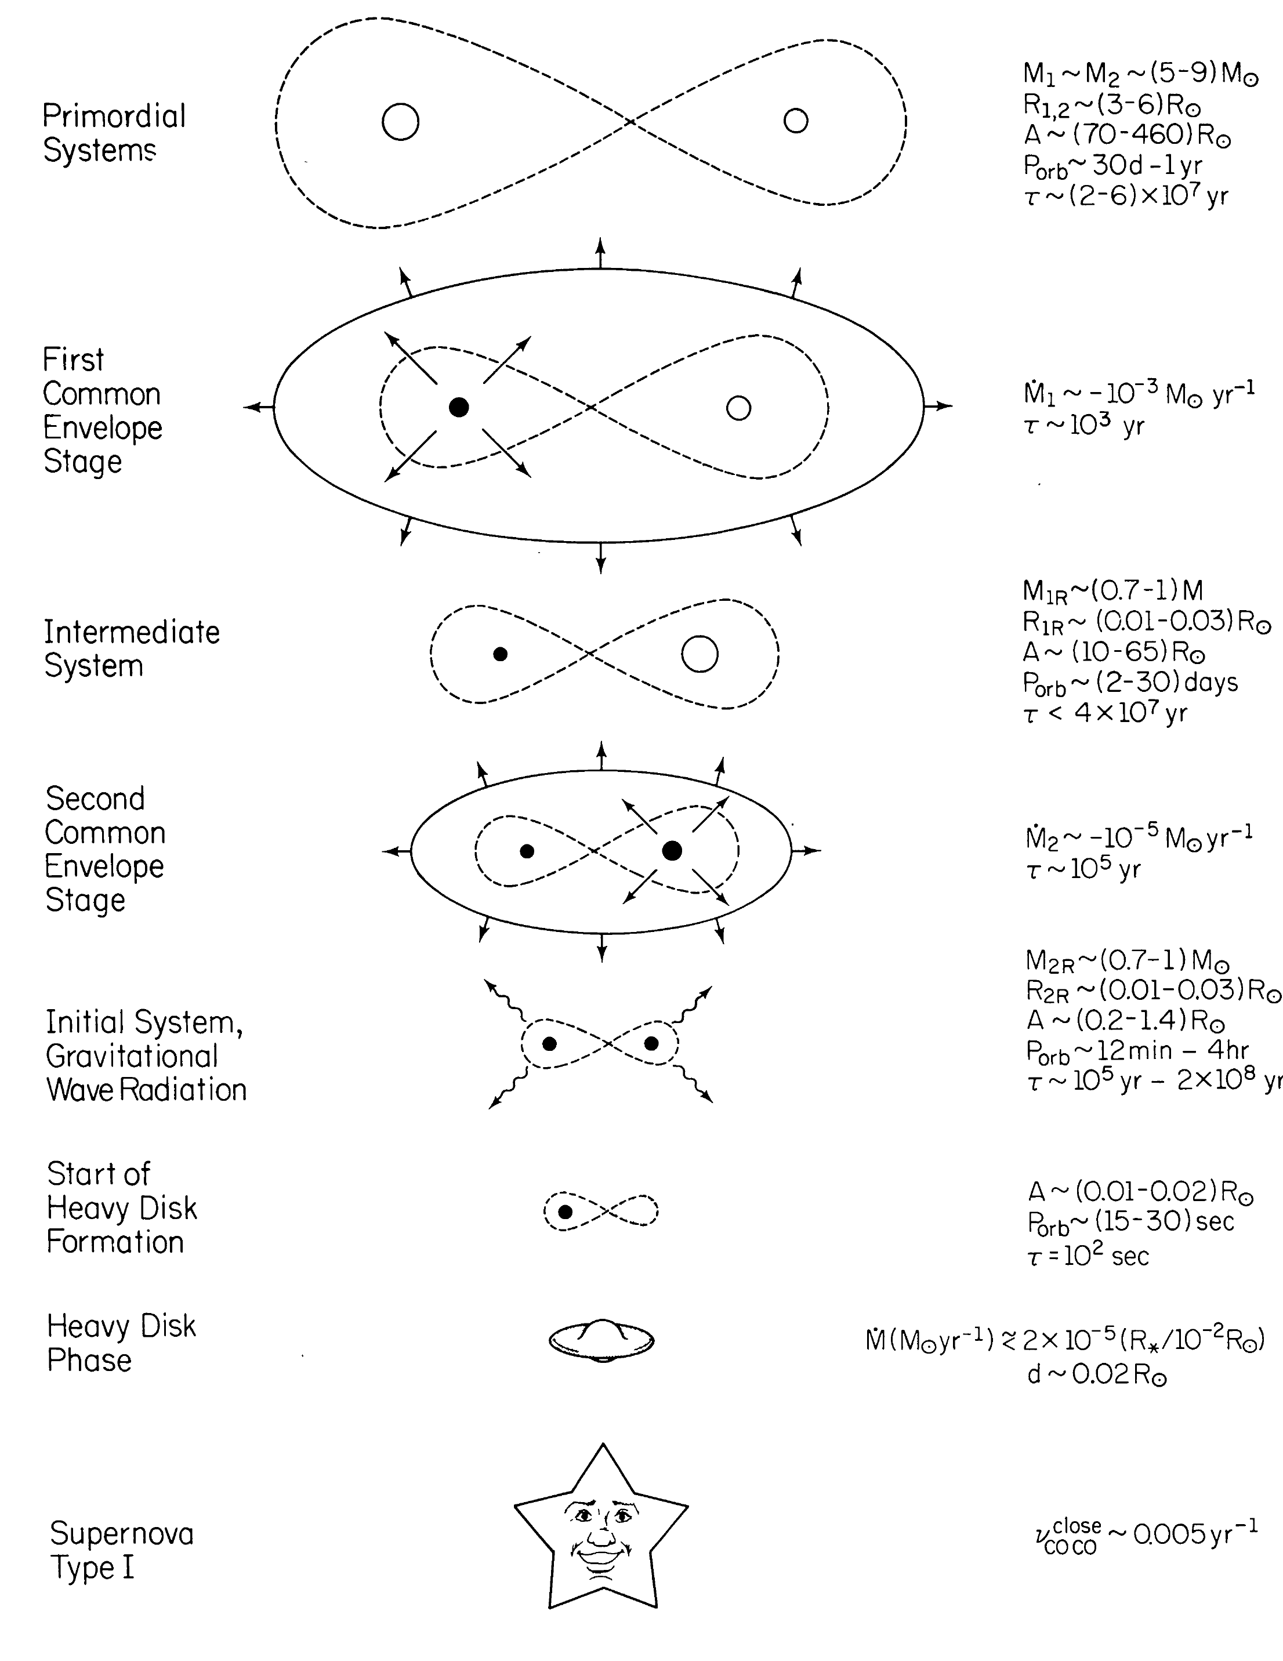
Is Rej 0317 a failed SNIa?
Binary scenario explains
the rapid rotation, high mass and magnetism.
Is it consistent with the missing total age of RE J0317-853 ?
Double degenerate scenario for SNIa from Iben & Tutukov 1984

Slide 7
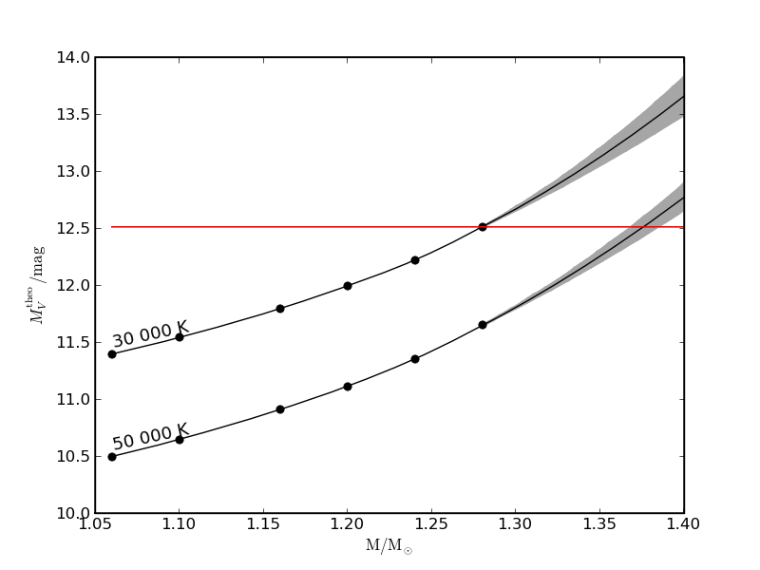
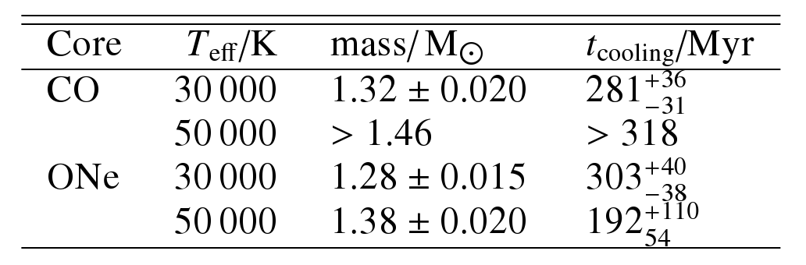
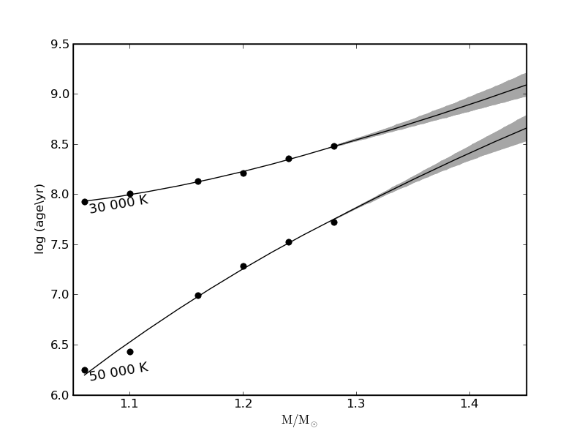
Vobs
π = 33.279 ±0.238 mas
d = 30.048 ±0.215 pc
HST parallax
Mv
Teff
CO core:
Holberg & Bergeron 2006
RWD
M/R Relations
WD Evolution
ONe core:
Althaus et al. 2007
MWD
MWD
tcool
tcool
IFMR
Bertelli et al. 2009
tprog
tevol

Slide 8
Evolutionary Scenarios
LB 9802
RE J 0317
Teff = 30 000 K
RE J 0317
Teff = 50 000 K
280 Myr
280 Myr
190 Myr
Single
~50 Myr
Single
~50 Myr
~240 Myr
Merger
>200 Myr
130-170 Myr
~330 Myr
Merger
>200 Myr
>290 Myr
410-450 Myr
>480 Myr

Slide 9
Evolutionary Scenarios
CO, ONe 30 000 K
Not enough time for binary evolution
Age discrepancy solved if mass underestimated due to magnetism
ONe 50 000 K
Time satisfactory for binary evolution
Age discrepancy cannot be explained by mass underestimation

Slide 10
Spectral Methods

Slide 11
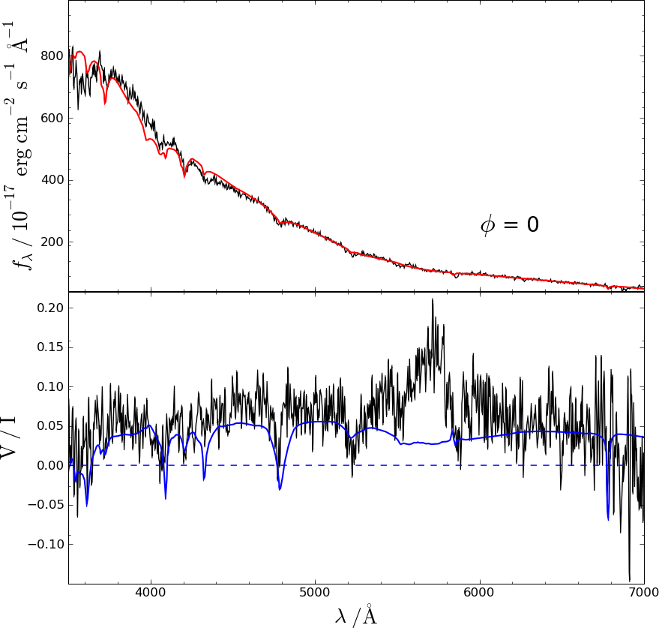
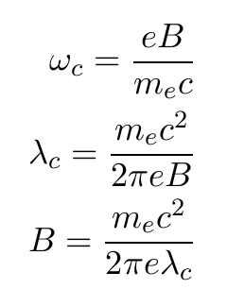

Strong circular polarization
Optical spectrum of the phase with uniform weak field

Slide 12
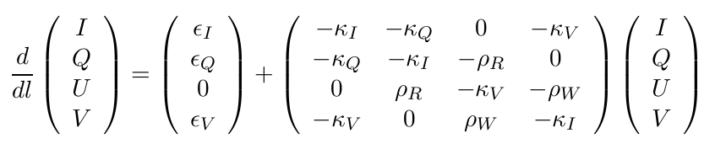
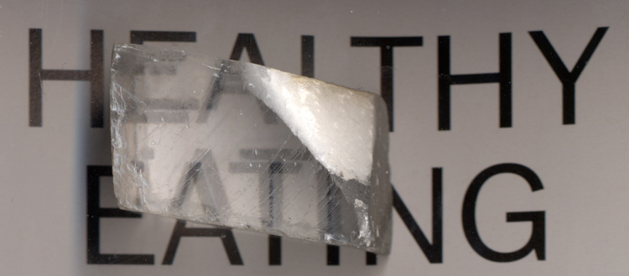
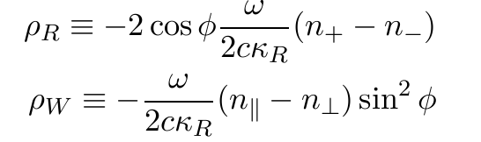
Radiation Transfer
Magneto-optical parameters are measures of birefringence

Slide 13

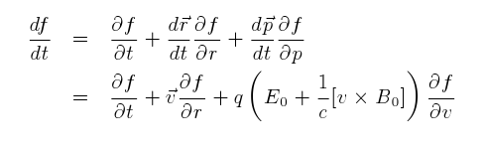

Cyclotron 
Elementary theory; equation of motion of one
electron under the effect of magnetic field
Pacholczyk 1970
Ramaty 1969
Boltzmann equation, evolution of the distribution function of an ensemble of electrons under Lorentz force
Bekefi 1966
Zhelenzyakov & Zlotnik 1980
Pavlov 1980

Slide 14
Strong circular polarization

Slide 15
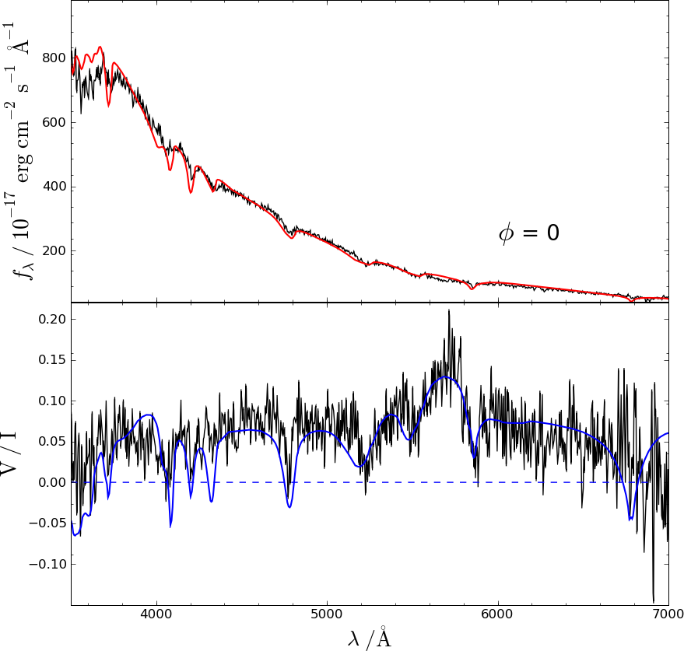
Strong circular polarization

Slide 16
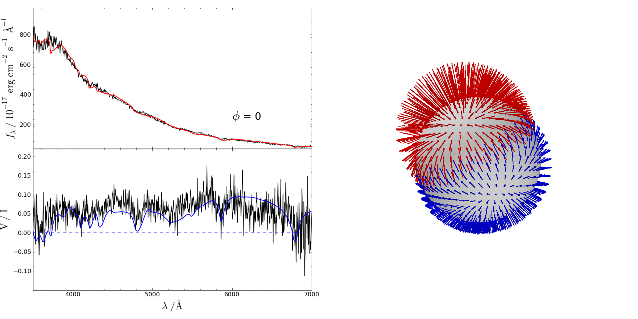
Fit with offset dipole
B ≈ 140 – 550 MG

Slide 17
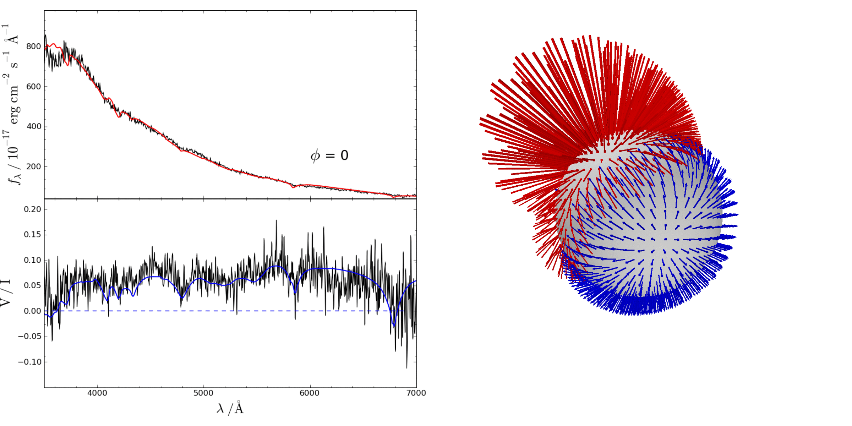
Fit with offset dipole + quadrupole + octupole
B ≈ 140 – 900 MG

Slide 18
Conclusions
Understanding RE J0317-853
  Parallaxes prove the evolutionary connection with LB 9802
  Evolutionary origin is an open question
  Plasma properties for MWD atmospheres at cyclotron frequencies constructed
  The strong polarization of RE J0317-853 is due to cyclotron absorption
Future prospects
  Consistently model Teff
  Distinguish between the evolutionary scenarios

Slide 19
The End

Slide 20
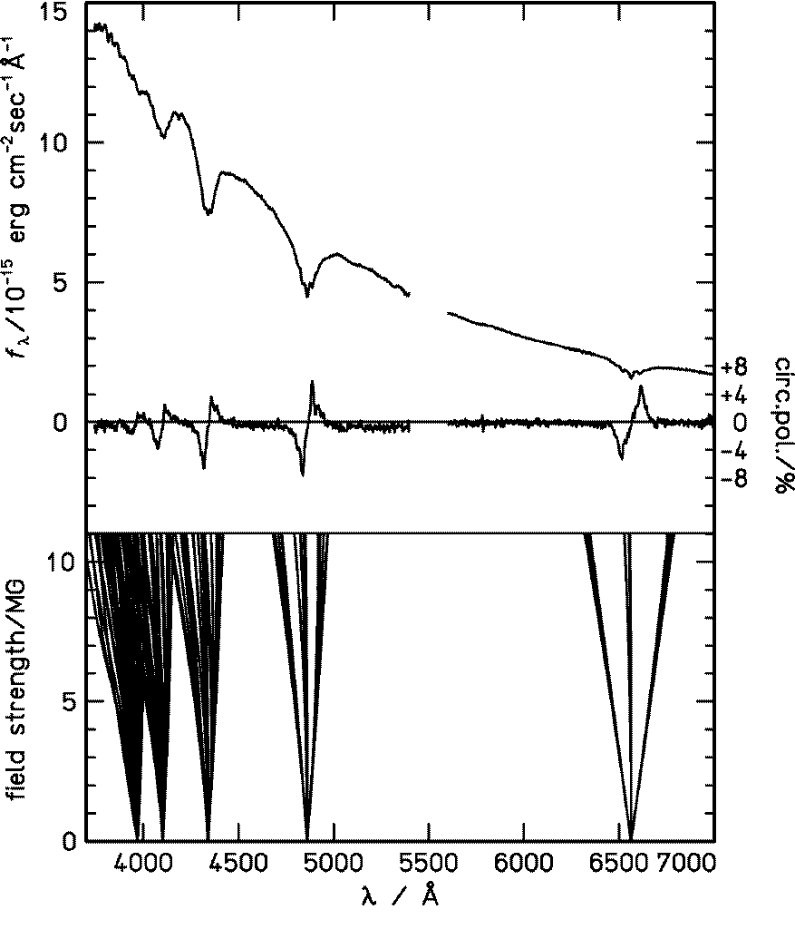
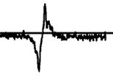
High Field MWD
Spectrum of PG 1658+440
Bd ~ 5 MG
In relatively low fields (~10⁷ G):
Splittings are apparent
Δm = +1
circular polarization
Δm = -1
position of line components

Slide 21
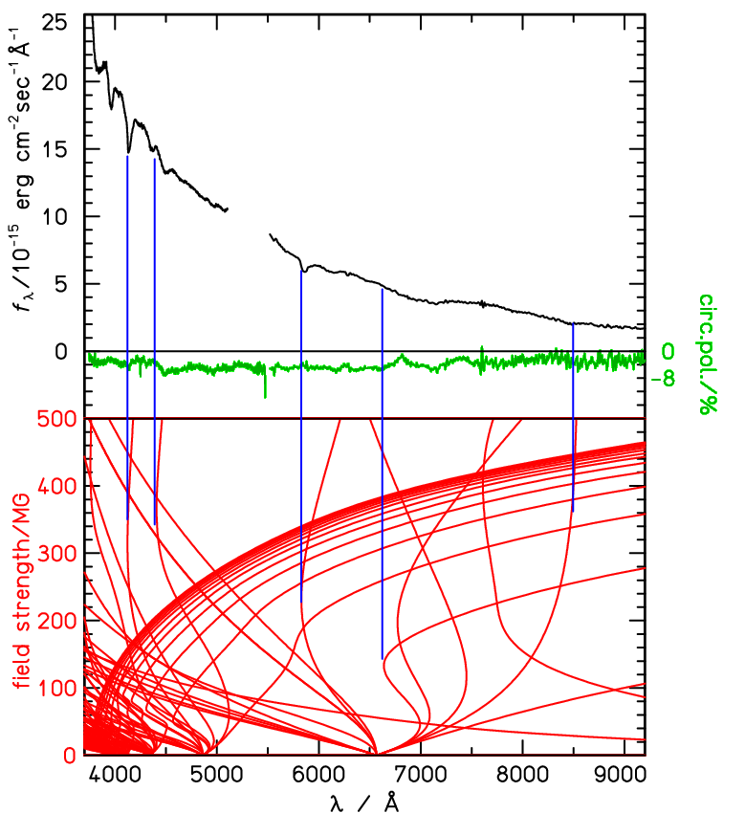
Even High-er Field MWD
In high fields (>10⁸ G):
Line shifts are large -> smearing due to B variation over surface
Only “Stationary lines” are prominent
circular polarization
position of line components
Spectrum of Grw+70º 8247
Bd ~ 300 MG

Slide 22
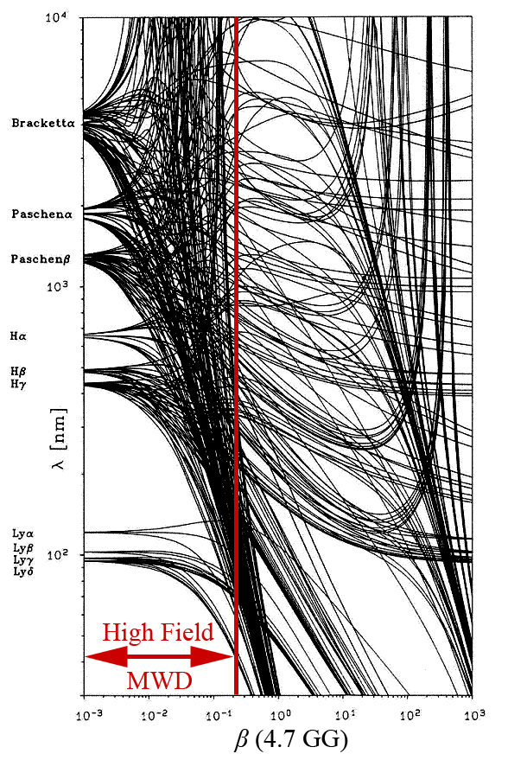
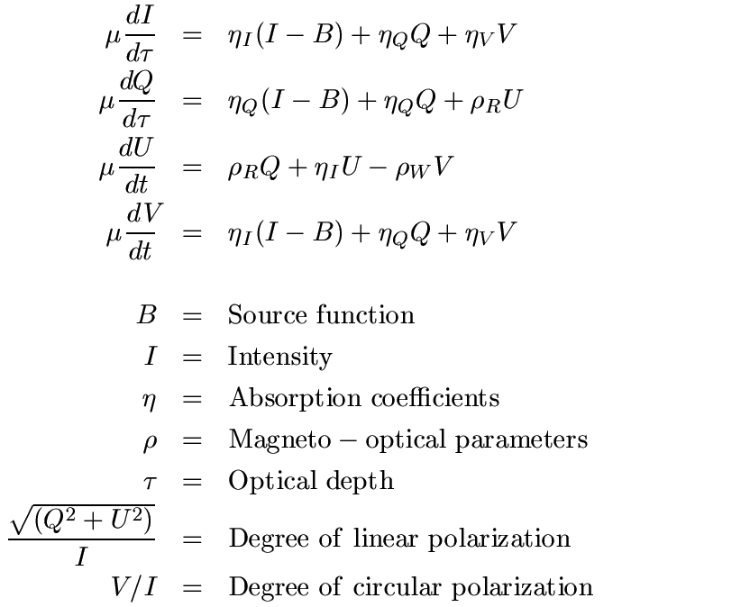
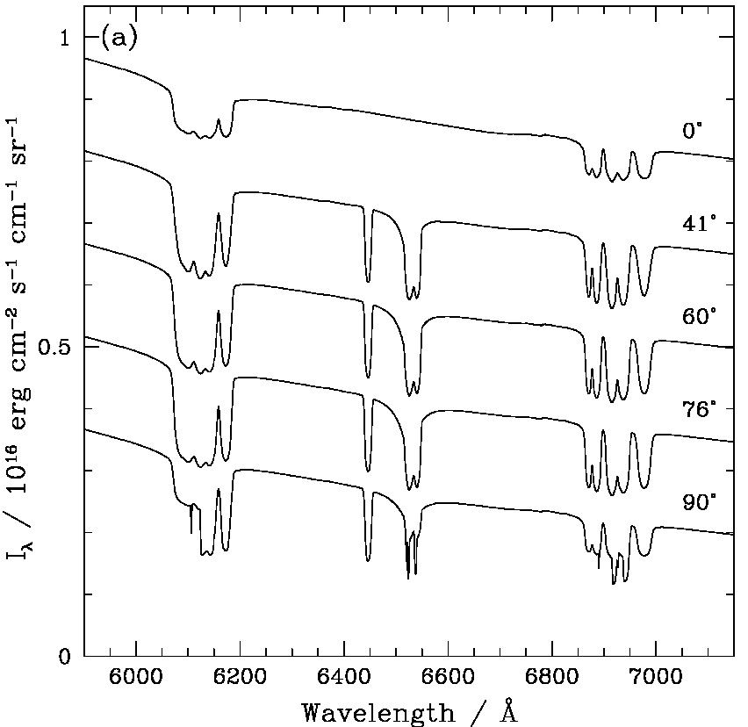
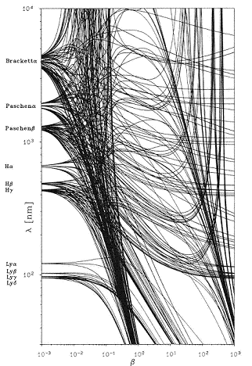
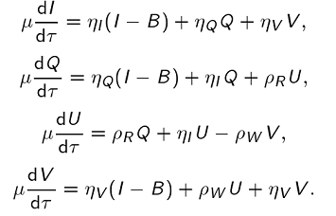
Database
Line + Continuum Opacities
Calculation of Stokes Parameters
Database of Synthetic Spectropolarimety for Various B, T, cosφ

Slide 23




Integration
Area
B vector
|B|
B modulus
angle information
plus:
limb darkening

Slide 24
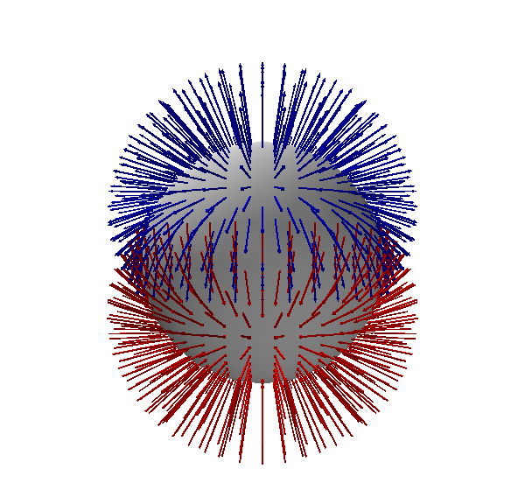
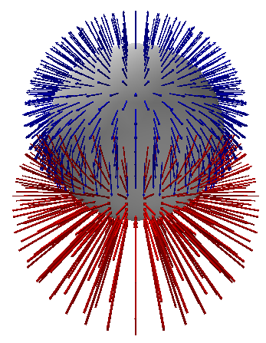
Magnetic Models
dipolar
non-dipolar

Slide 25
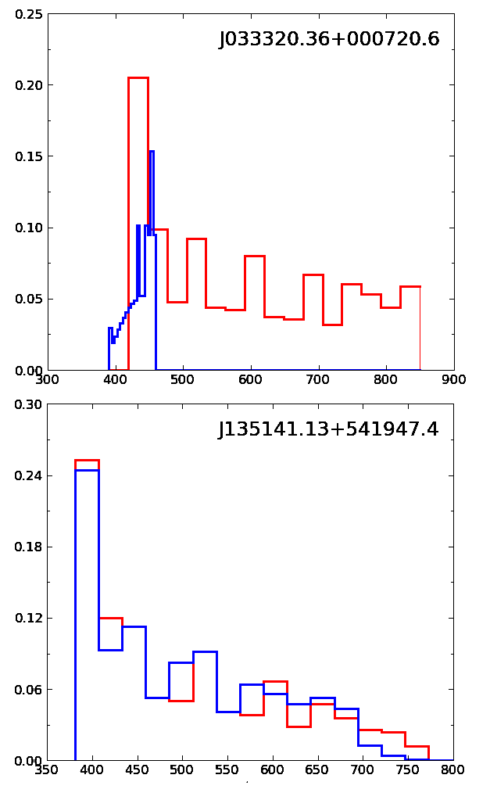
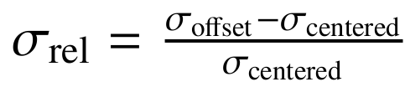


non-dipolar
Normalized contribution of each bin
~ 0
dipolar
B / MG

Slide 26
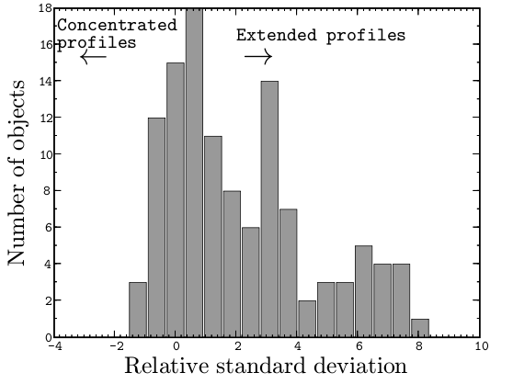
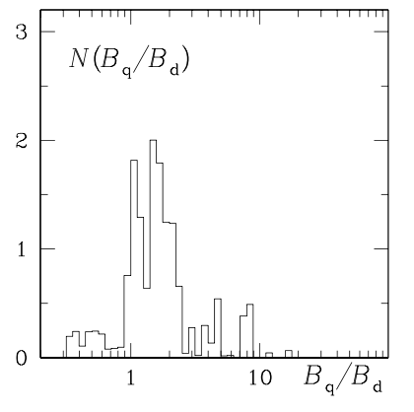
MWDs (Külebi et al. 2009)
Ap/Bp (Bagnulo et al. 2002)
dipolar
dipolar
non-dipolar
~60% non-dipolar
63% non-dipolar

Slide 27
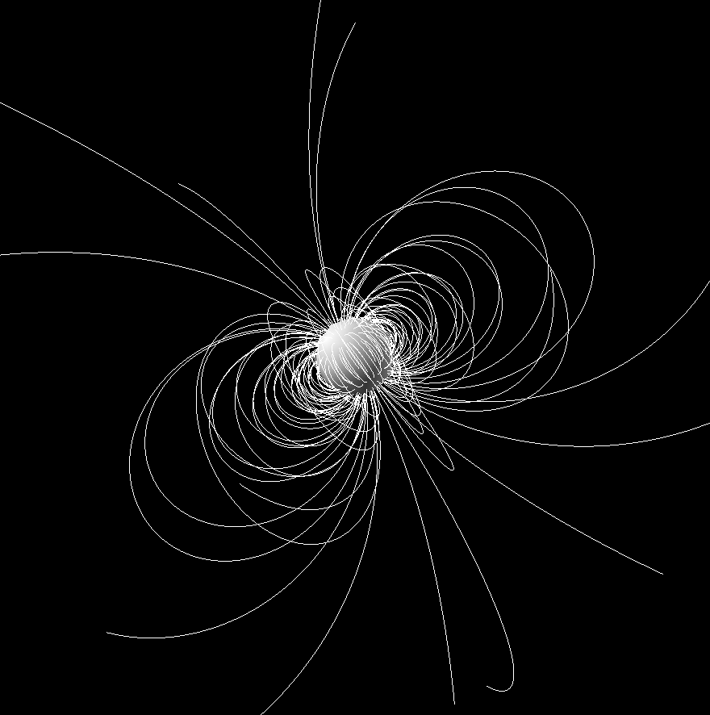
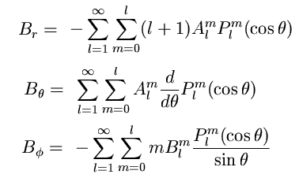
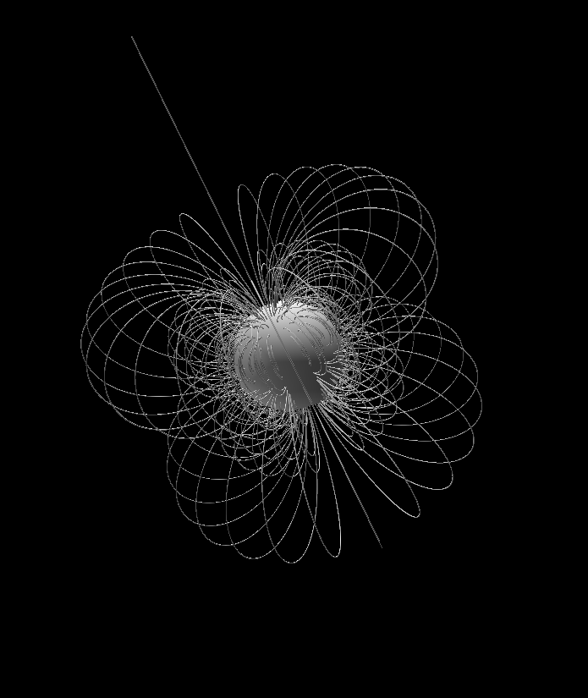
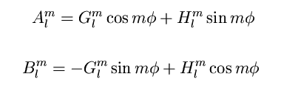
Geometry
dipole (l = 1, m = 0)
quadrupole (l = 2, m = 0)

